Slide 1
Agentive Workflow for Dental Assisting Course Administration

Slide 2
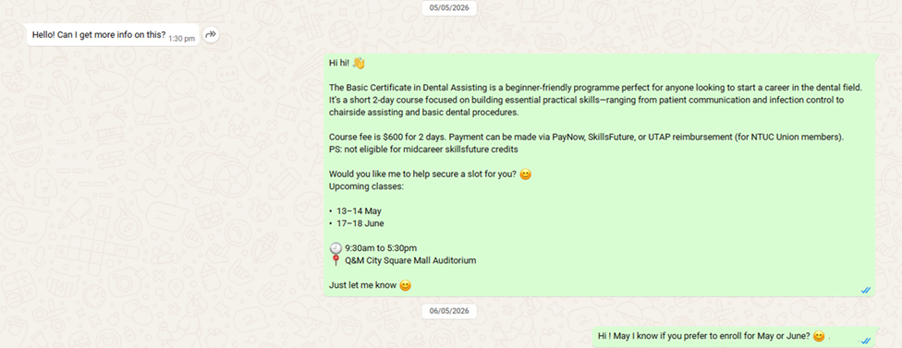
Step 1: Receiving enquiries from FB Ads
Upon receiving enquiries, Agent to send an introductory message
If no reply after 30 mins, send the first follow up message.
2nd Follow up message: 1 day later.
3rd Follow up message: 2 days later.

Slide 3
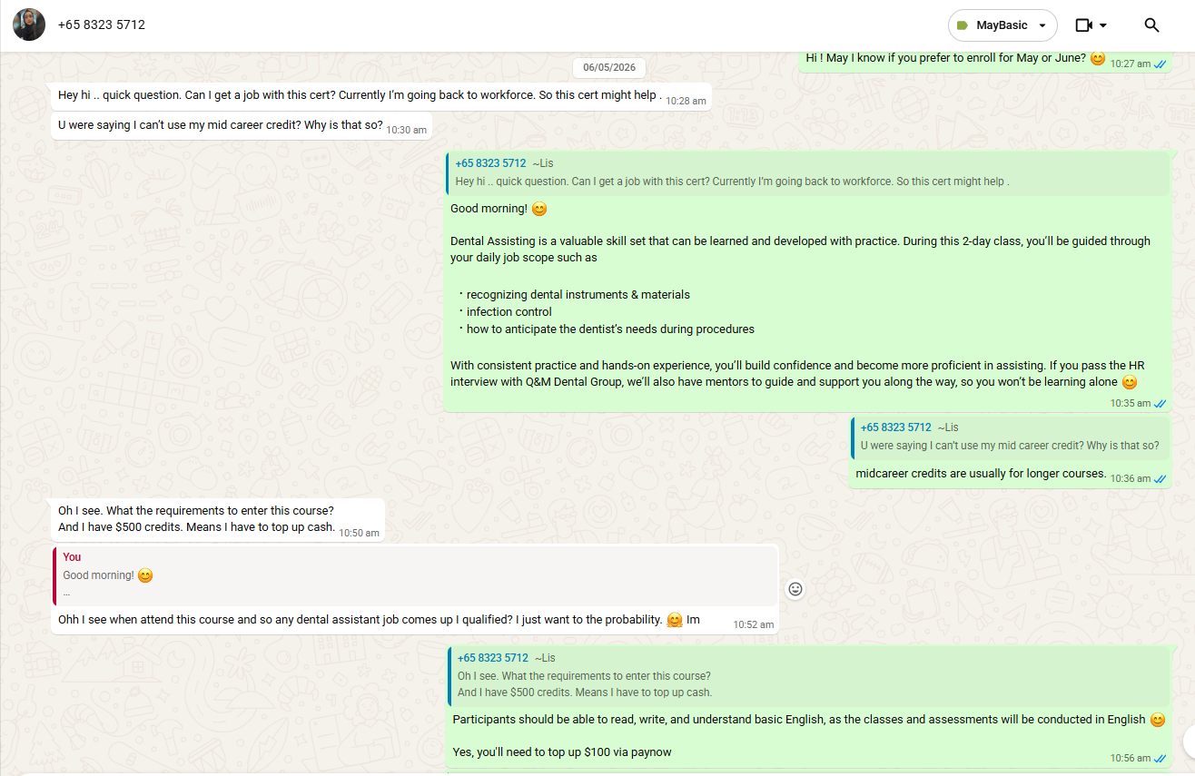
Step 2a: Answering Participants Queries

Slide 4
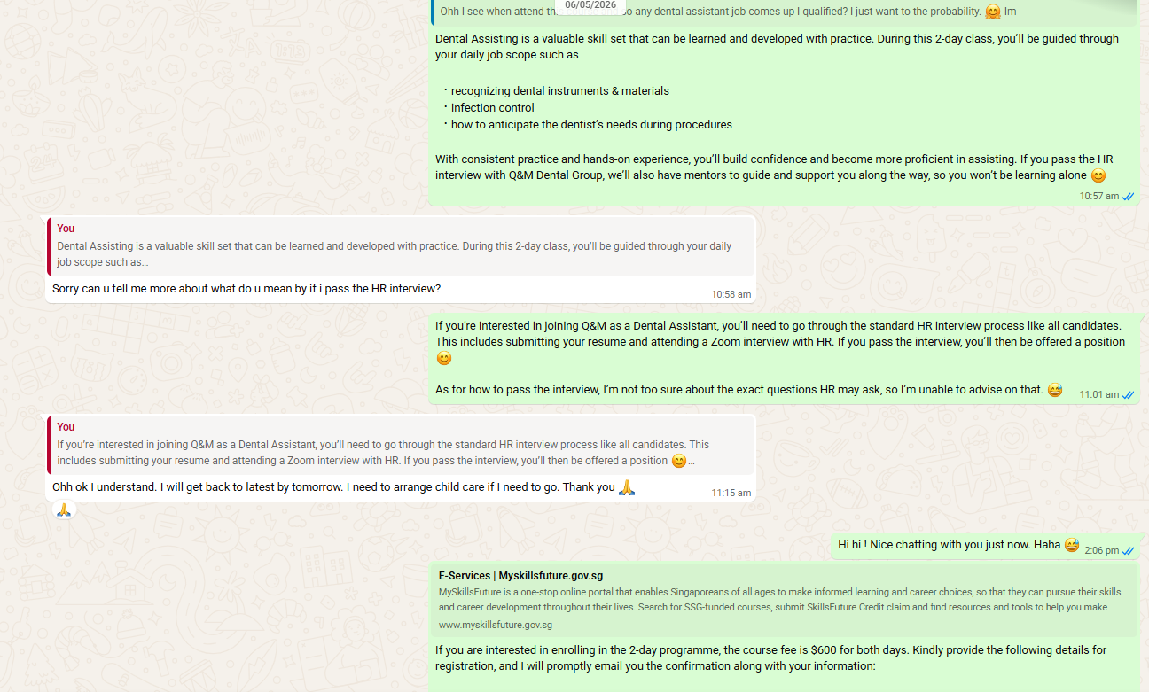
Step 2b: Answering Participants Queries

Slide 5
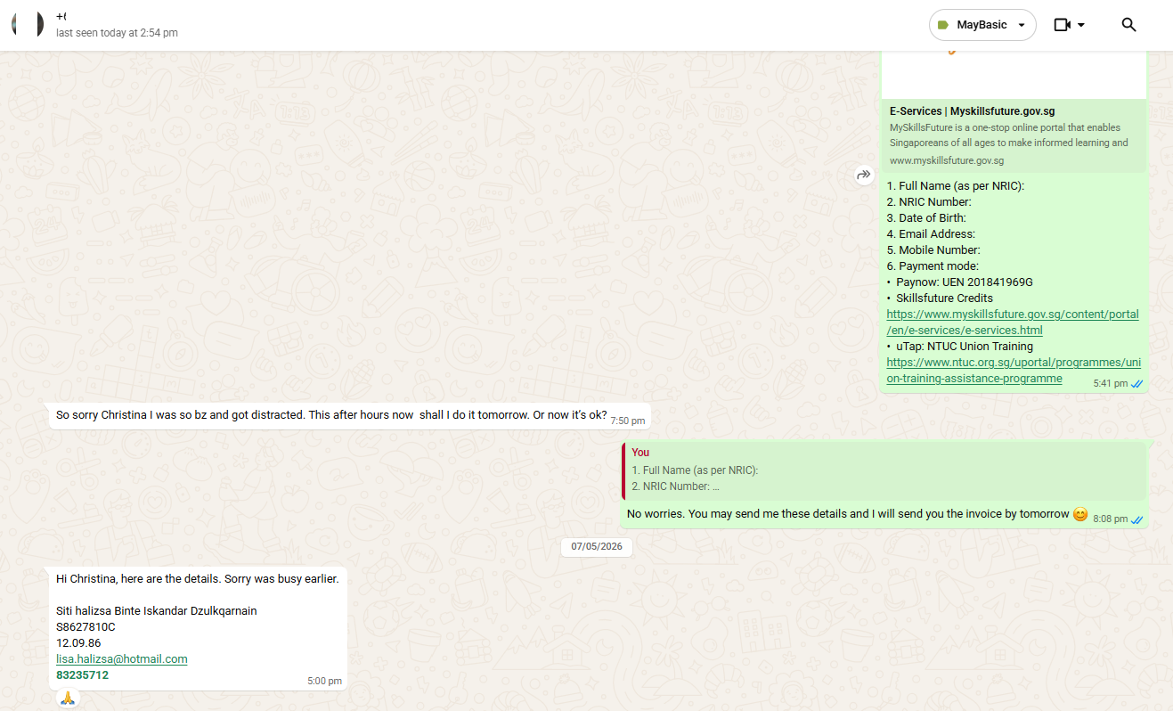
Step 3: Ask candidate for details
Ask candidate for details
To confirm date selected for course and confirm amount via Paynow & SFC

Slide 6
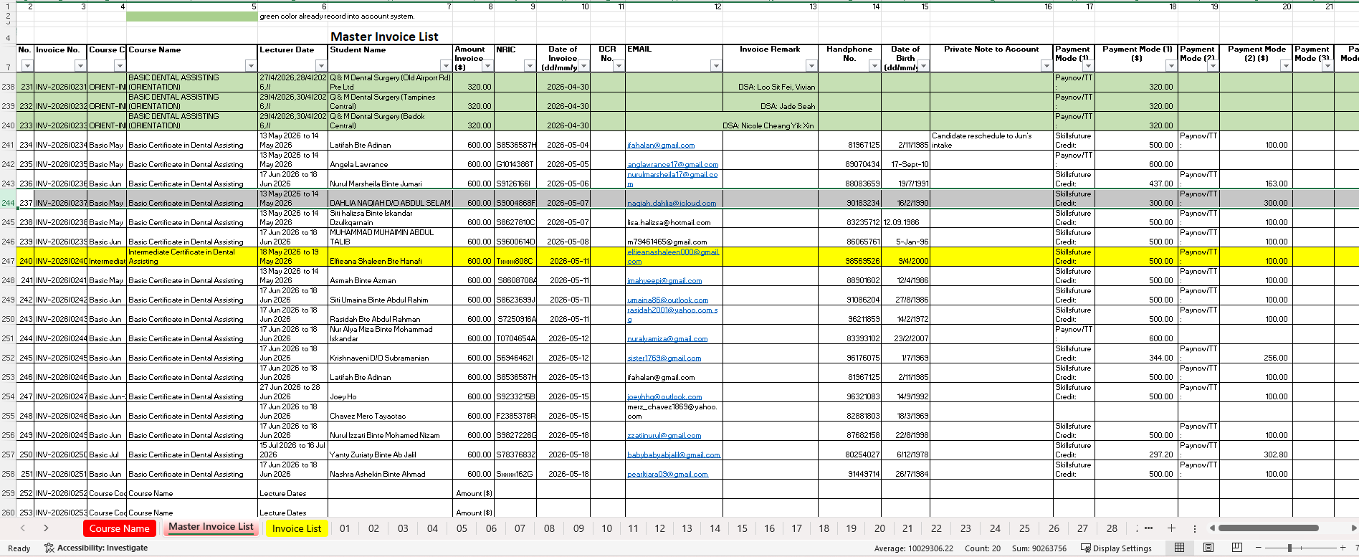
Step 4: Agent to key in details into excel from whatsapp
2
1
Choose Master Invoice Tab
Agent to select appropriate selection from Course name, Key in Name, NRIC, invoice date, email, HP, email, DOB, amount from Paynow and SFC

Slide 7
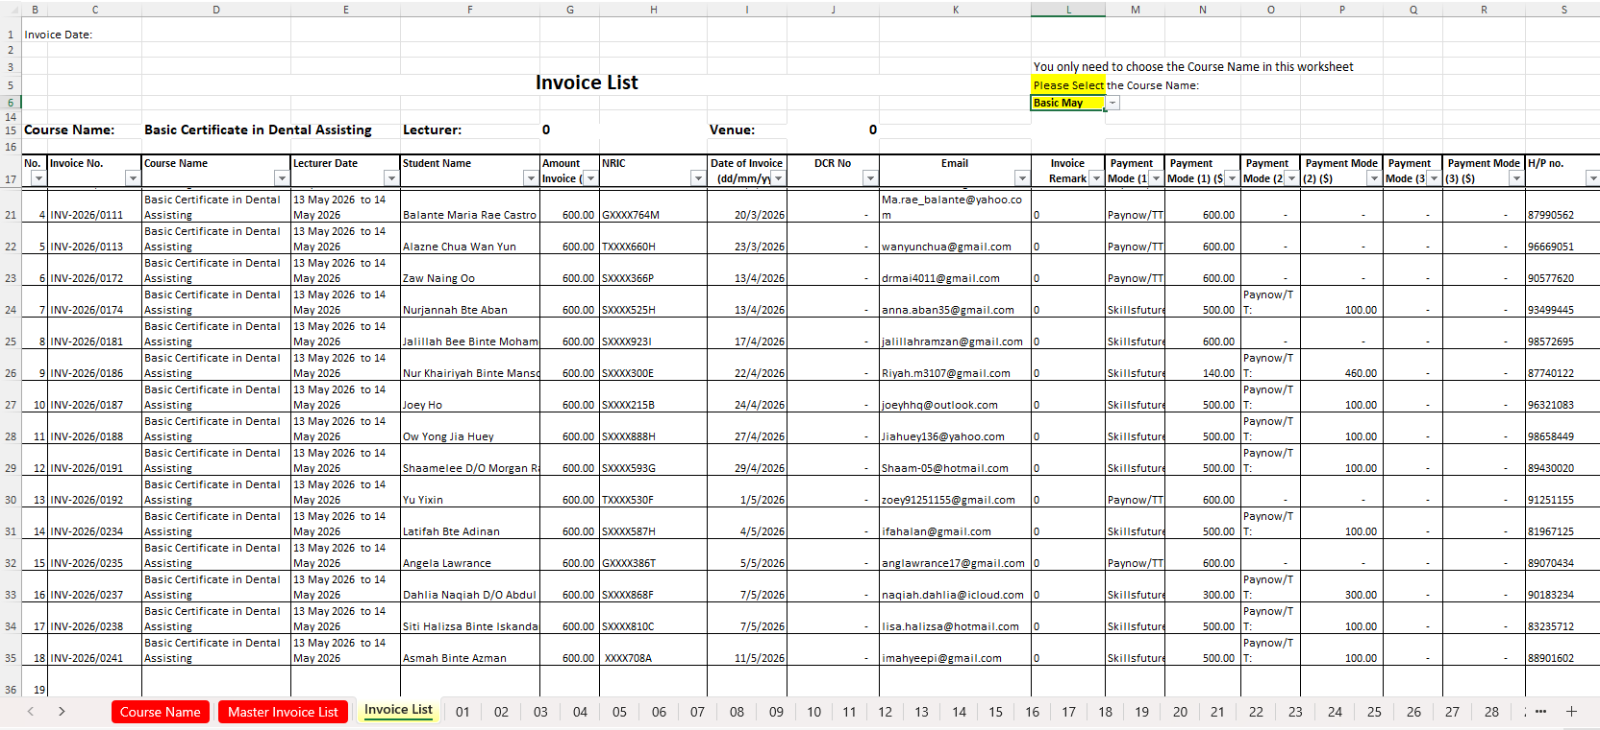
Step 5: Agent to generate invoice using excel
1
2
Choose invoice number and save PDF

Slide 8
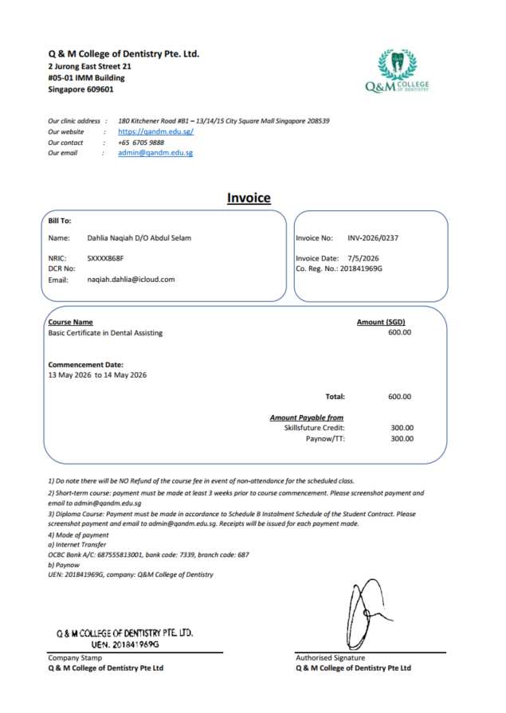
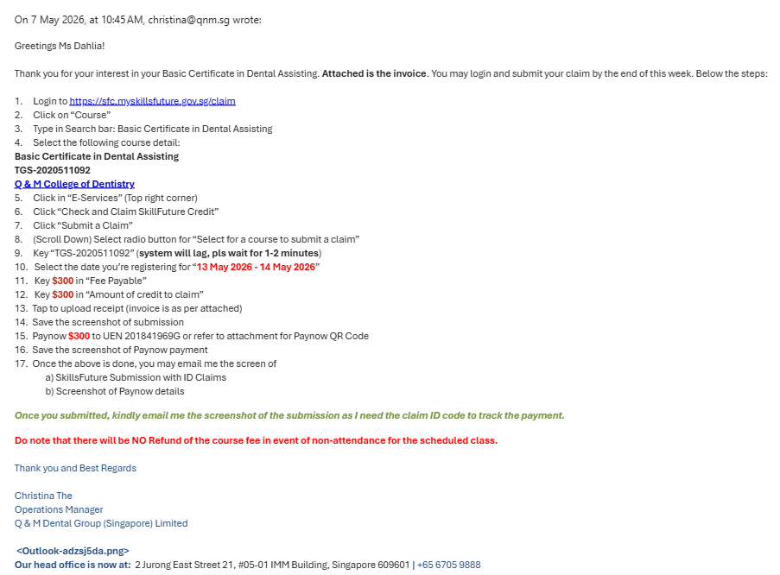
Step 5: Agent to email candidate Invoice
2
1
Agent to chop co’s stamp, insert e-signature
Email to candidate on instructions to submit claim in SSG portal

Slide 9
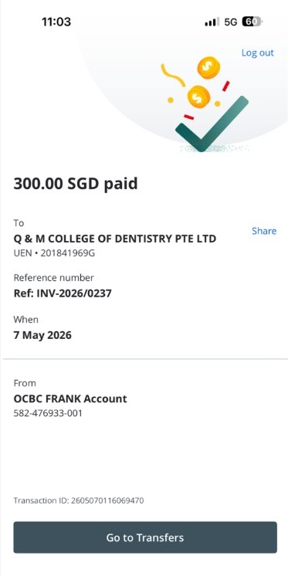
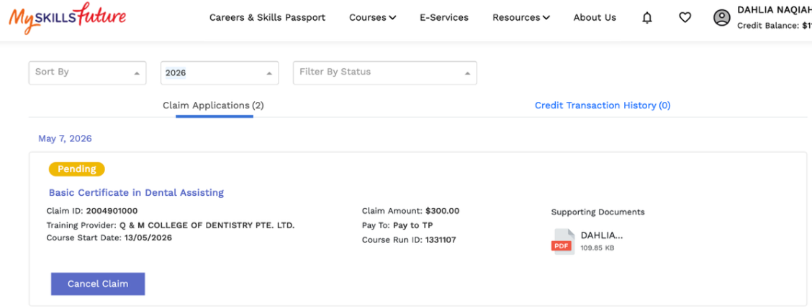
Step 6: Candidate to email agent screenshots

Slide 10
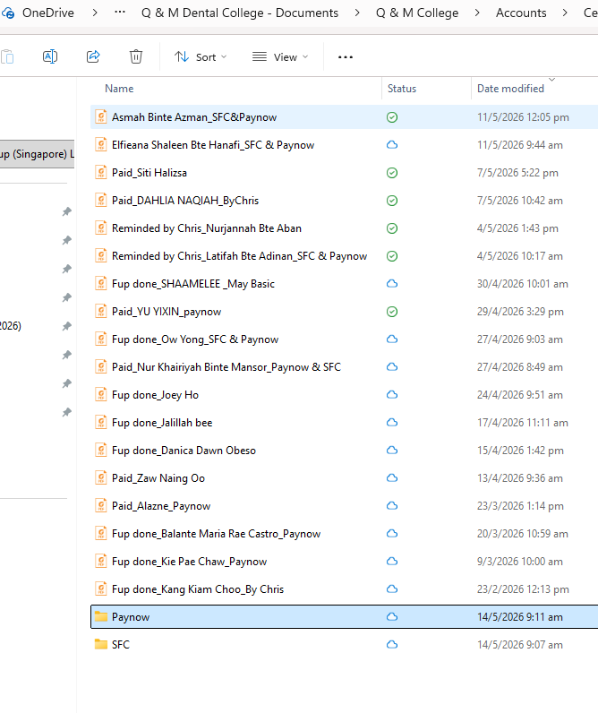
Step 7: Agent to save screenshot in OneDrive Folder
Invoice
Paynow Screenshot
SFC Screenshot
1
2 & 3

Slide 11
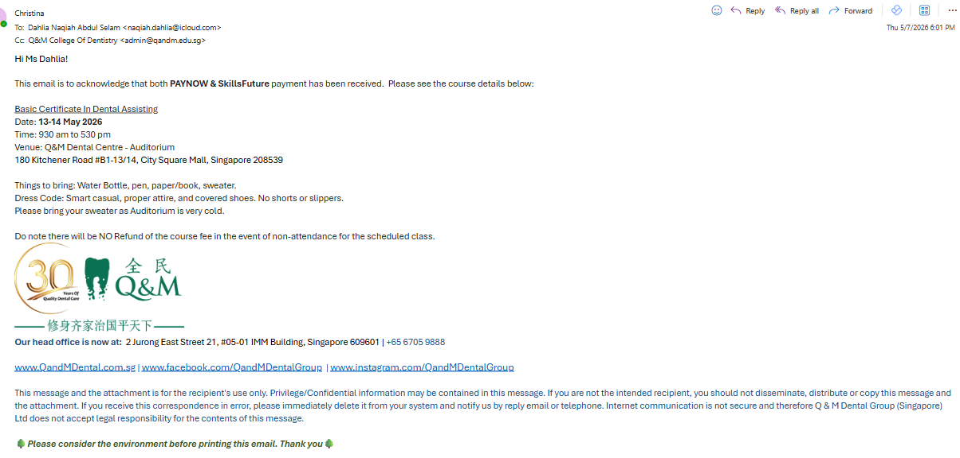
Step 8: Agent to email candidate confirmation

Slide 12
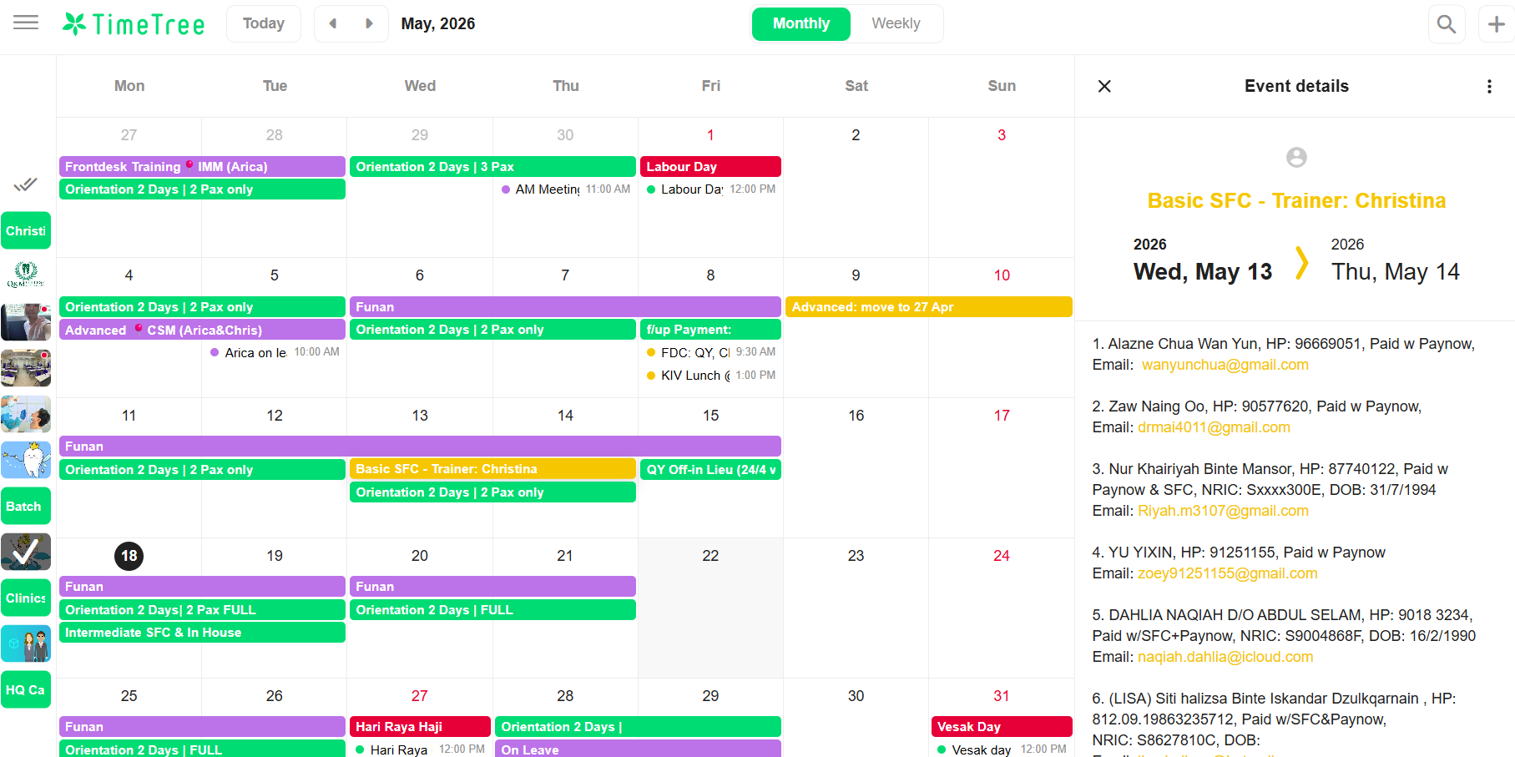
Step 9: Agent to key in participants in Timetree

